Slide 1
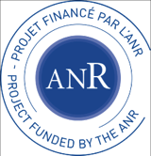



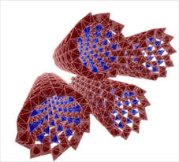
Safe(r) and Ecodesign Research and Education applied to NAnomaterial DEvelopment
“The new generation of materials safer by design”
Coordination CEREGE:
Directors : JY Bottero, J Rose
Deputy director : A Masion
Financial and administrative director: S. Pekar-Bonifay
Scientific and outreach manager: C. de Garidel-Thoron
Administrative manager : B. Bourlion
Safer and Ecodesign Research and Education applied to NAnomaterial DEvelopment

Slide 2
TITLE in Bold Italic Gill Sans MT (Titres) [39]
Your name here (in Bold Italic Gill Sans MT [28])
University/department affiliation (in normal Gill Sans MT [24])
email@place.fr
Safer and Ecodesign Research and Education applied to NAnomaterial DEvelopment

Slide 3
SERENADE aknowledgement statement
SERENADE basic aknowledgment statement for use at end of papers :
en français : « Ce travail réalisé dans le cadre du Labex SERENADE portant la référence ANR-11-LABX-0064 a bénéficié d'une aide de l’Etat gérée par l'Agence Nationale de la Recherche au titre du Projet Investissements d’Avenir A*MIDEX portant la référence n°ANR-11-IDEX-0001-02.»
in english : « This work has been carried out in the framework of the Labex SERENADE (ANR-11-LABX-0064) and of the A*MIDEX project (ANR-11-IDEX-0001-02), funded by the «Investissements d’Avenir» French Government program managed by the French National Research Agency (ANR).»

Slide 4



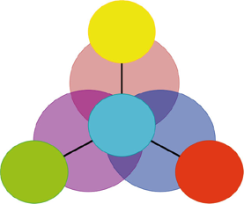


Here are some handy logos you may want to use

Slide 5













Here are some handy logos you may want to use

